Slide 1
SMART HOME SYSTEM Using Atmeg32 AVR
BY: Nouran , Sara , Nada ☺

Slide 2
Table of contents
01
02
03
04
Introduction
System Components
Flow chart
Feature
05
Proteus connection

Slide 3
01
Introduction

Slide 4
Key Features
Programming: Eclipse was the coding hub.
Simulation: Used Proteus for seamless integration.
Microcontrollers: Paired ATmega32
Display/Input: LM016L LCD & Mobile application ( Serial Bluetooth terminal) for user-friendly interaction.
Lighting: 3 LEDs for rooms and garden lights.
Climate Control: LM35 & ADC for fire alarm system.
Security: Not allowing invalid users, blocked after 3 password trials or user trails.
User Interface: LCD displays menu; Mobile app for inputs .
Interrupts: Ensured system responsiveness to unforeseen events.

Slide 5
02
System components

Slide 6
System components
LCD
LM35 Temperature Sensor
Atmega32 AVR Microcontroller
LDR
Buzzer
DC Motor
LED
Servo Motor
Bluetooth module HC-05

Slide 7

03
Flow chart

Slide 8
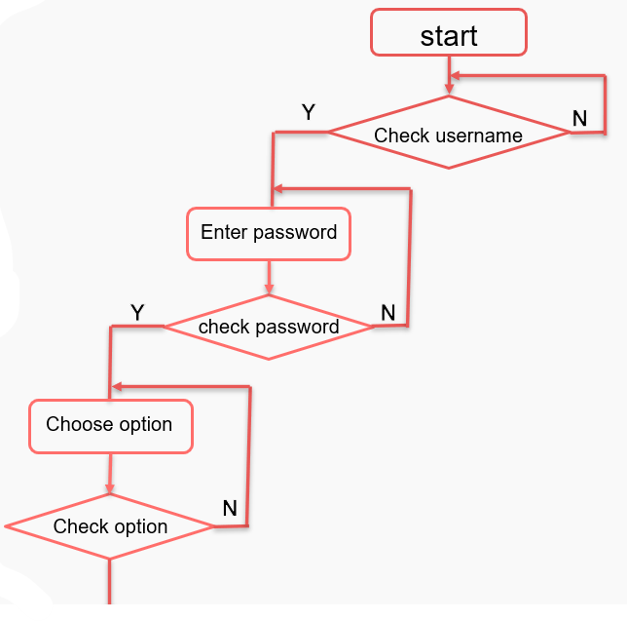
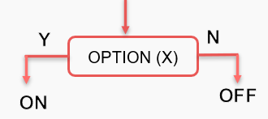

Slide 9

04 Features

Slide 10
Features
Using mobile application
DOOR
FAN
ROOM LIGHT
Open and close door using SERVO MOTOR
Control fan using
DC MOTOR
Control 3 rooms in the house
OPEN
CLOSE
ON
CLOSE
ON
CLOSE

Slide 11
Features
Interrupt
FIRE ALARM SYSTEM
GARDEN LIGHTS
Sensing temperature using LM35 if
Sensing light using LDR
> 70
Turn on BUZZER
> 30
Turn on Fan
> 20
Turn off Fan
> 512
LED ON
<512
LED OFF

Slide 12
05 Proteus connection
CSS
</>
HTML

Slide 13
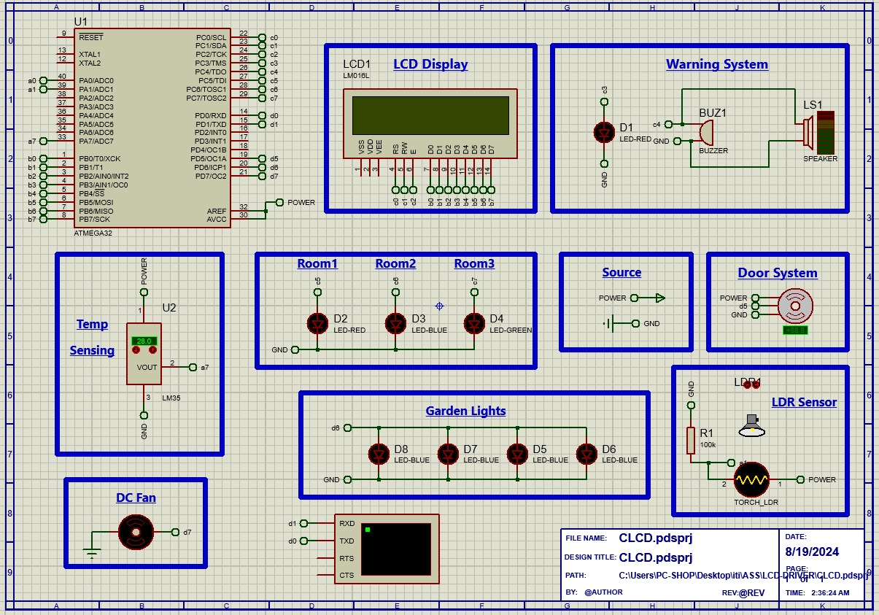

Slide 14


